Slide 1
CMIS 3142 - Computational Methods
T. Arudchelvam
Department of CMIS,
Faculty of Applied Sciences,
Wayamba University of Sri Lanka

Slide 2
Areas to be covered
Data Representation and Computational Error:
  Floating-point numbers, rounding rules, machine precision, floating-point arithmetic; well-posed problems, problems vs. algorithms, data error vs. computational error, forward error vs. backward error, conditioning of a problem, stability of an algorithm.
System of Linear Equations:
  Programming aspects for different types of matrices such as full matrix, symmetric matrix, sparse matrix, symmetric sparse matrix, row vector, column vector.
  Program Design for matrices and other relevant Operations, SOR (Successive over relaxation Method), Cholesky Method, ICCG (Incomplete Choleski Conjugate Gradient method).
  Program design for different problems using matrices
Fixed point iteration, Jacobian Matrix, Finite Difference Method

Slide 3
Error Analysis

Slide 4
Accuracy and Precision
Accuracy refers to how closely a computed or measured value agrees with the true value, while precision refers to how closely individual computed or measured values agree with each other

Slide 5
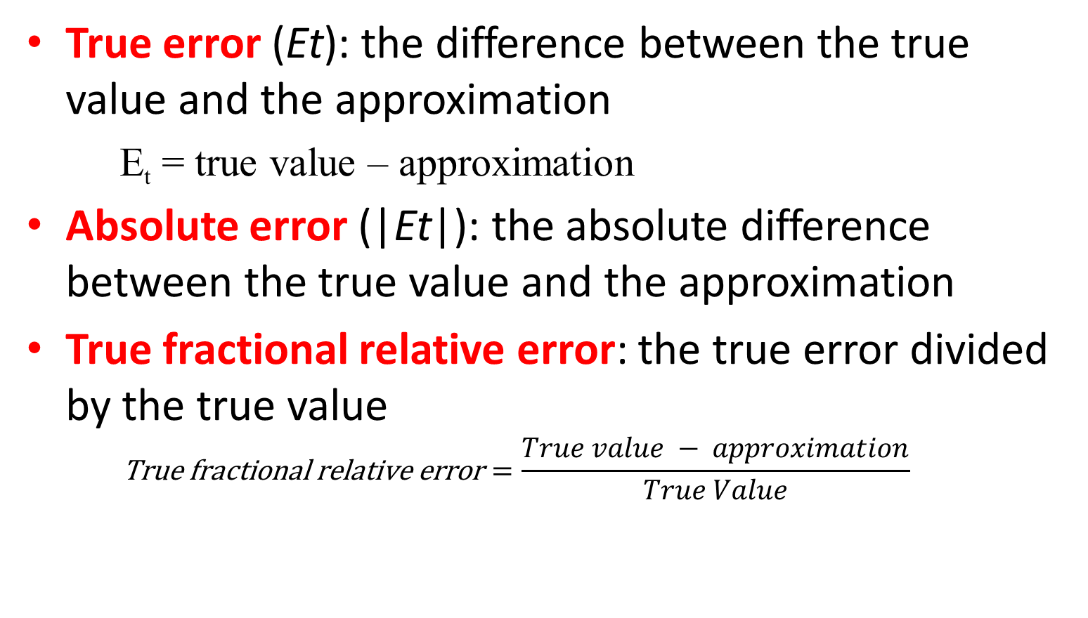
Error
True error (Et): the difference between the true value and the approximation
  E_{t} = true value – approximation
Absolute error (|Et|): the absolute difference between the true value and the approximation
True fractional relative error: the true error divided by the true value
  $$\text{True} \text{fractional} \text{relative} \text{error}=\frac{True value − approximation}{True Value}$$

Slide 6
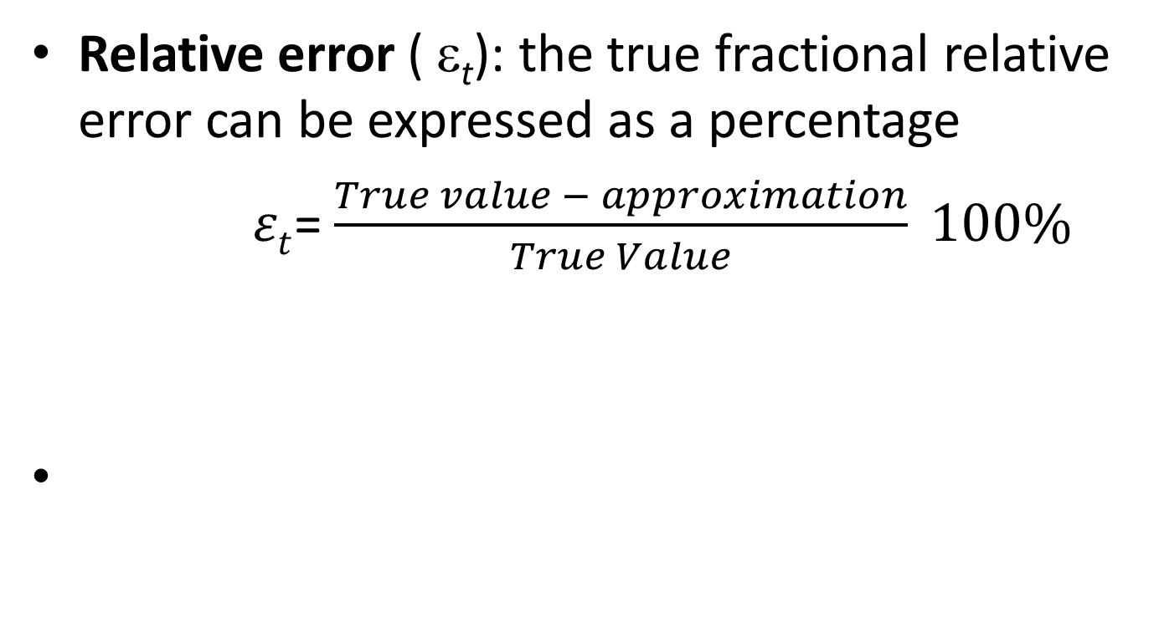
Relative error ( ε_{t}): the true fractional relative error can be expressed as a percentage
$εt$= $\frac{True value − approximation}{True Value} 100\%$

Slide 7
Error Types
Round off error
Chopping error

Slide 8
Round off error
A round-off error, also called rounding error, is the difference between the calculated approximation of a number and its exact mathematical value due to rounding.

Slide 9
Chopping / Truncation error
Truncation error is the difference between a truncated value and the actual value. A truncated quantity is represented by a numeral with a fixed number of allowed digits, with any excess digits "chopped off" (hence the expression "truncated").

Slide 10
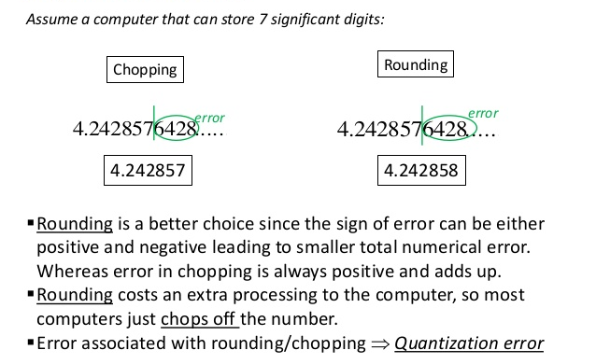
Chopping Vs Rounding

Slide 11
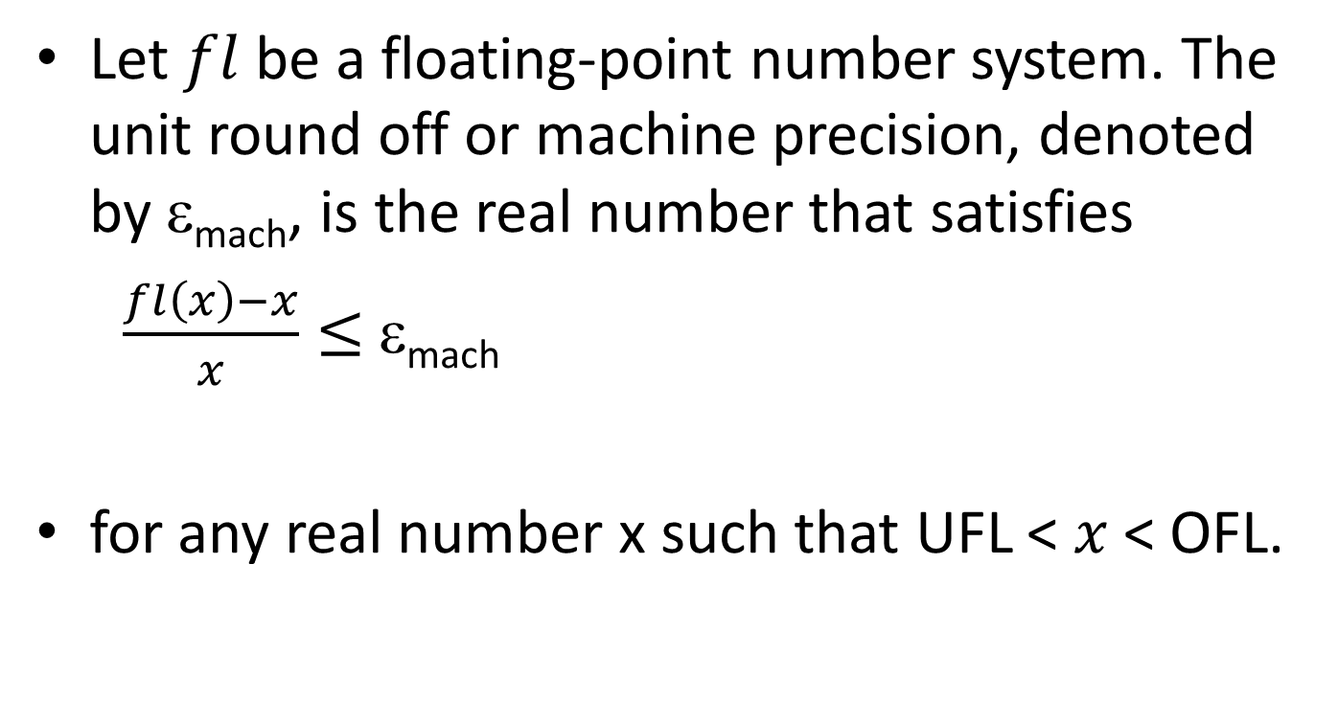
Machine Precision
Let $fl$ be a floating-point number system. The unit round off or machine precision, denoted by ε_{mach}, is the real number that satisfies
$\frac{fl\left(x\right)−x}{x}≤$ ε_{mach}
for any real number x such that UFL < $x$ < OFL.

Slide 12
Round off Errors with Arithmetic Manipulations
Round off error can happen in several circumstances other than just storing numbers - for example:
– Large computations - if a process performs a large number of computations, round off errors may build up to become significant

Slide 13
Arithmetic Manipulation
Adding a Large and a Small Number - Since the small number’s mantissa is shifted to the right to be the same scale as the large number, digits are lost
Let us add 0.001+4000 represented with 4-digit mantissa and 1-digit exponent
4x10³ + 0.000001x10³ = 4.000001x10³
= 4.000 x10³

Slide 14
Well-posed problems
According to Hadamard, a problem is well-posed (or correctly-set) if
  it has a solution,
  the solution is unique,
  the solution depends continuously on data and parameters.

Slide 15
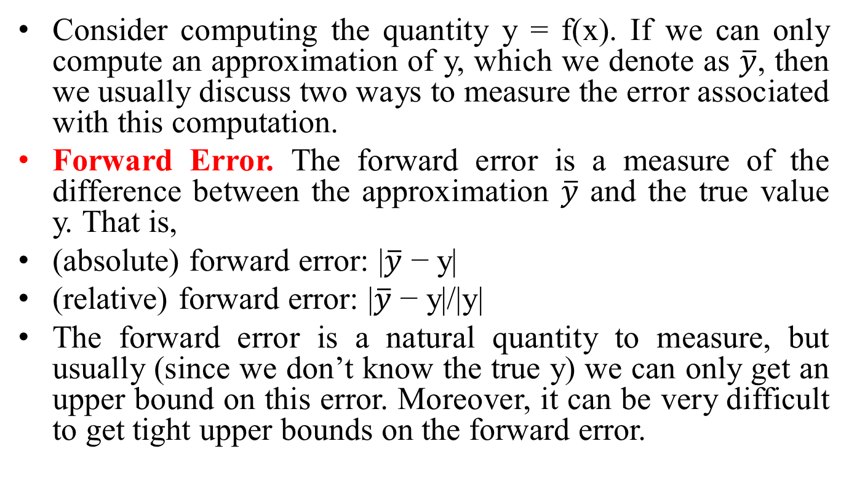
Forward Error and Backward Error
Consider computing the quantity y = f(x). If we can only compute an approximation of y, which we denote as $\overline{y}$, then we usually discuss two ways to measure the error associated with this computation.
Forward Error. The forward error is a measure of the difference between the approximation $\overline{y}$ and the true value y. That is,
(absolute) forward error: |$\overline{y}$ − y|
(relative) forward error: |$\overline{y}$ − y|/|y|
The forward error is a natural quantity to measure, but usually (since we don’t know the true y) we can only get an upper bound on this error. Moreover, it can be very difficult to get tight upper bounds on the forward error.

Slide 16
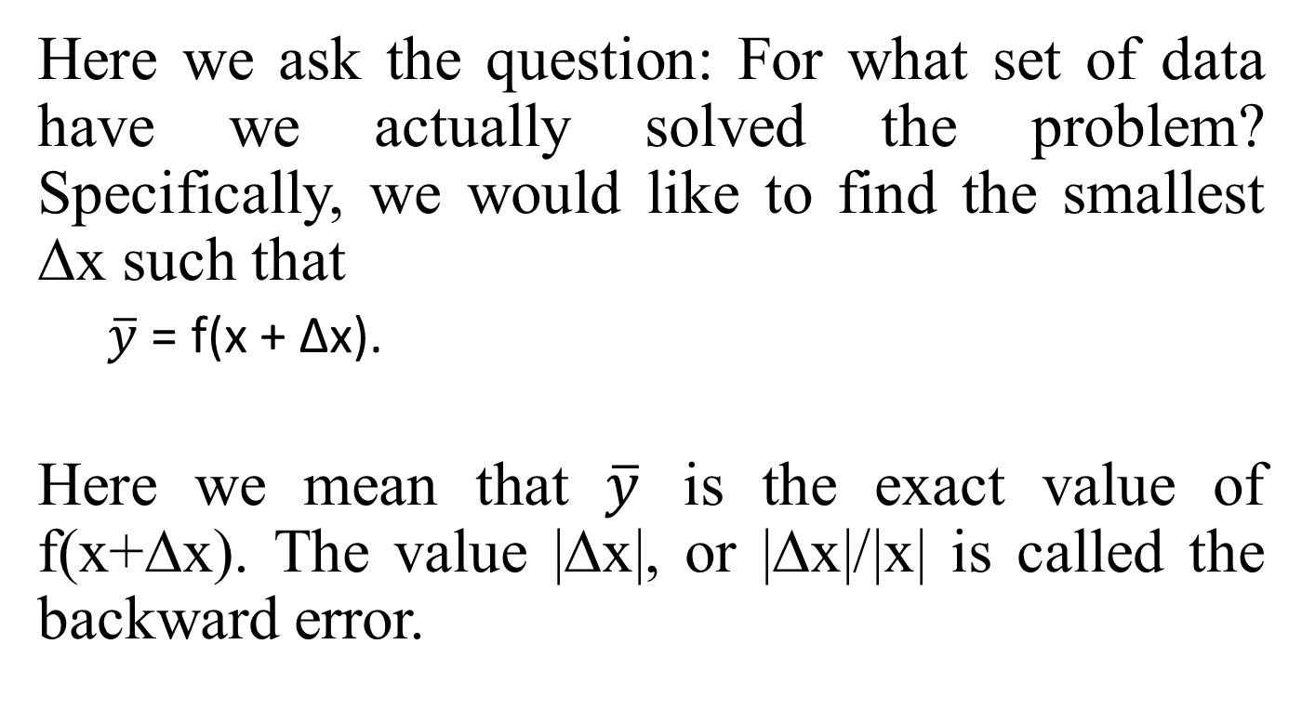
Backward Error
Here we ask the question: For what set of data have we actually solved the problem? Specifically, we would like to find the smallest ∆x such that
  $\overline{y}$ = f(x + ∆x).
  Here we mean that $\overline{y}$ is the exact value of f(x+∆x). The value |∆x|, or |∆x|/|x| is called the backward error.

Slide 17
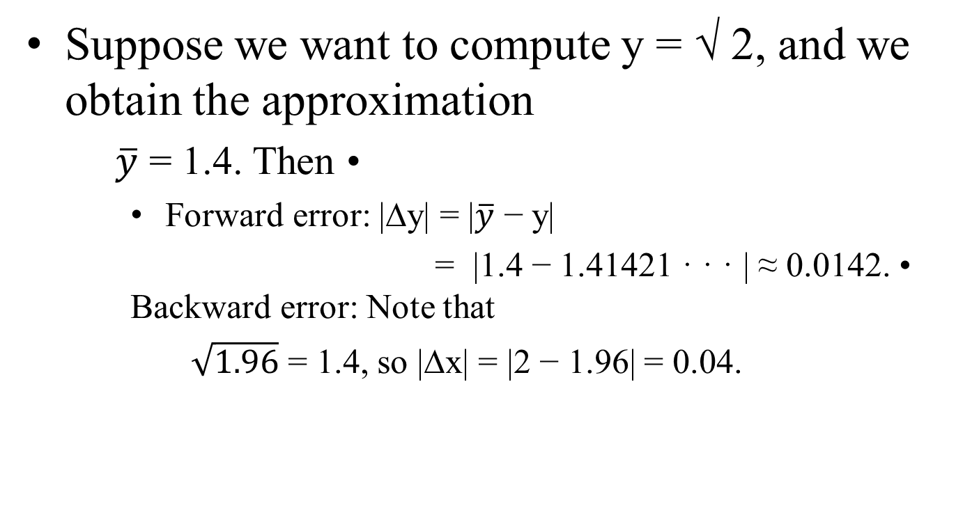
Example
Suppose we want to compute y = √ 2, and we obtain the approximation
  $\overline{y}$ = 1.4. Then •
    Forward error: |∆y| = |$\overline{y}$ − y|
    = |1.4 − 1.41421 · · · | ≈ 0.0142. • Backward error: Note that
    $\sqrt{1.96}$ = 1.4, so |∆x| = |2 − 1.96| = 0.04.

Slide 18
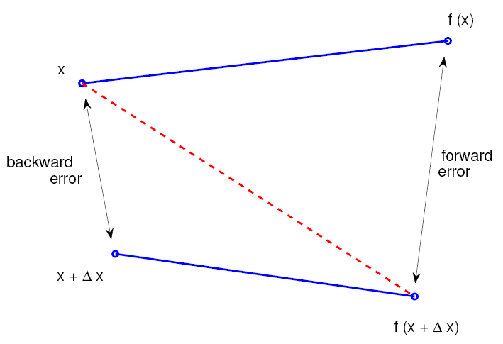
Conditioning (or sensitivity of a problem)
A mathematical problem with input x and output y = f(x) is:

Slide 19
Well conditioned if small changes in x lead to small changes in y.
Ill-conditioned if small changes in x can lead to large changes in y.
How can we measure conditioning?

Slide 20
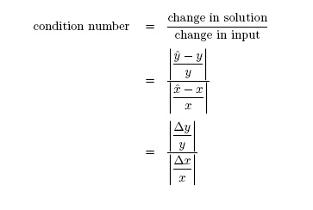

Slide 21
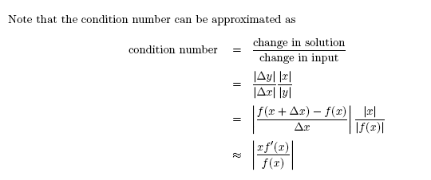

Slide 22
Stability (or sensitivity of an algorithm)
An algorithm is stable if the result it produces is relatively insensitive to errors made during the computations. That is, the result it produces is the exact solution of a nearby problem.
Stability of an algorithm does not guarantee an accurate computed solution. Accuracy depends on conditioning of the problem and stability of an algorithm

